Slide 1
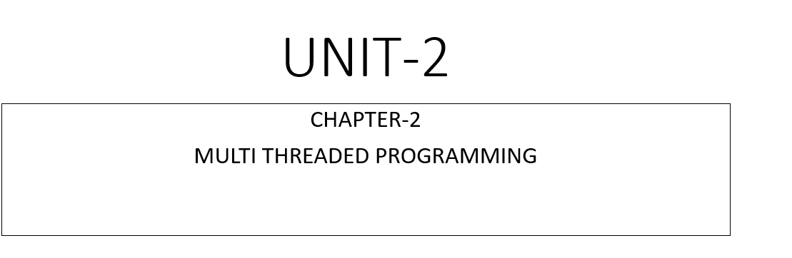
Dept. of CSE(CS), MSRIT

Slide 2
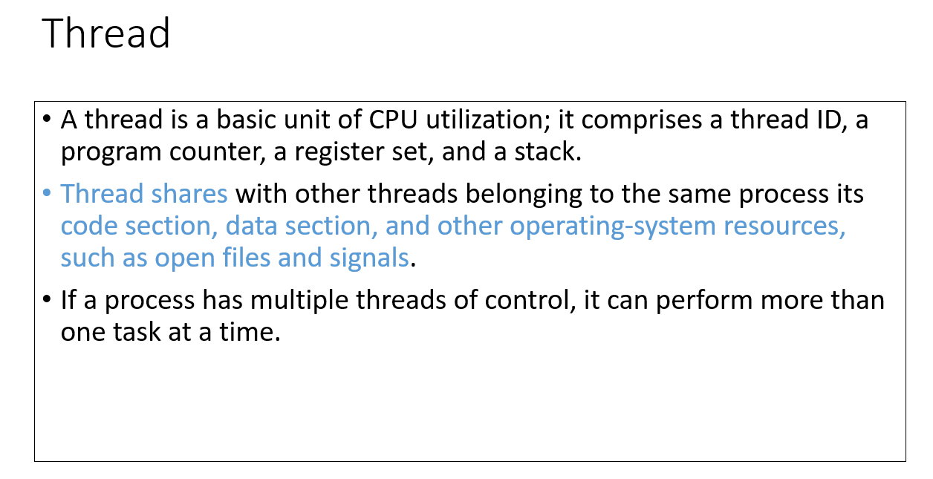
Dept. of CSE(CS), MSRIT

Slide 3
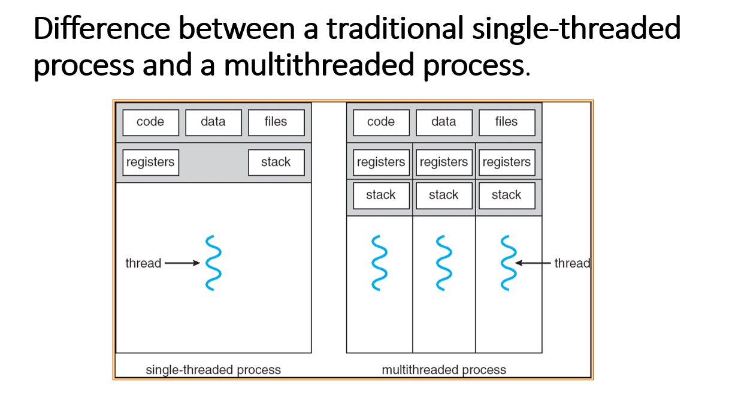
Dept. of CSE(CS), MSRIT

Slide 4
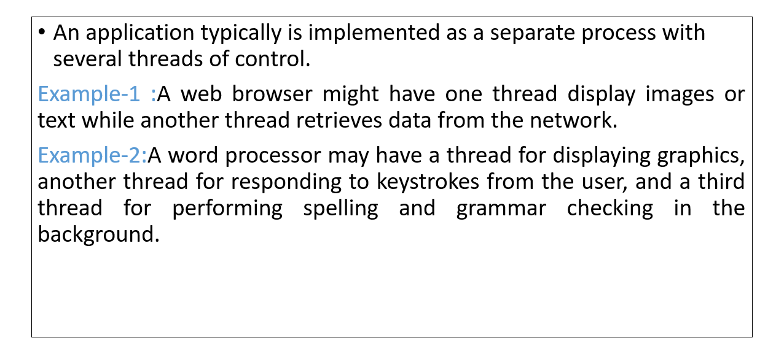
Motivation
Dept. of CSE(CS), MSRIT

Slide 5
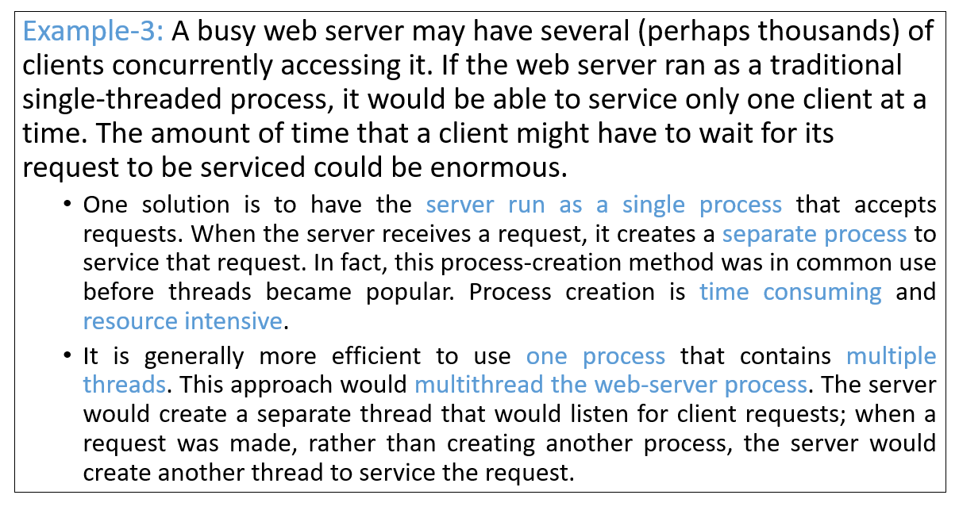
Motivation
Dept. of CSE(CS), MSRIT

Slide 6
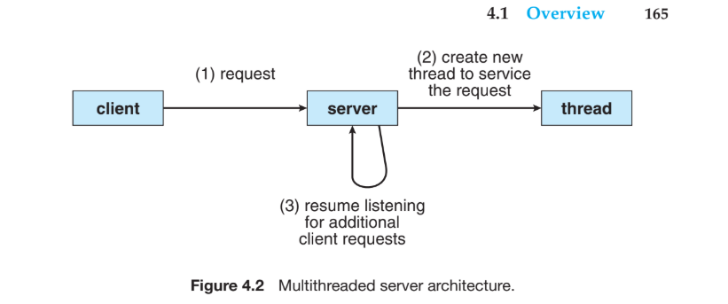
Motivation
Dept. of CSE(CS), MSRIT

Slide 7
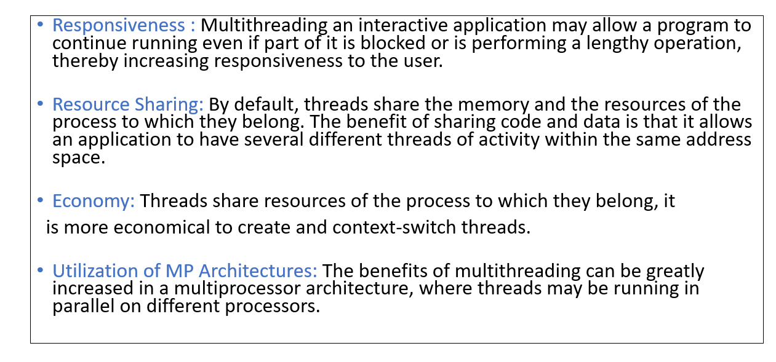
Benefits
Dept. of CSE(CS), MSRIT

Slide 8
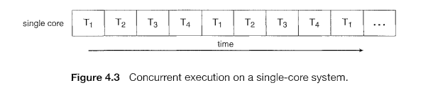
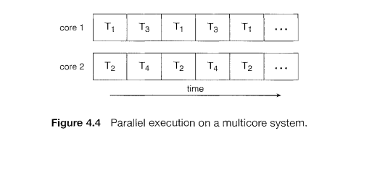
Multicore Programming
Multicore systems allow multiple threads to execute in parallel, improving performance compared to single-core systems where threads only interleave execution as the processing core is capable of executing only one thread at a time..shown in below fig.
On a system with multiple cores, however, concurrency means that the threads can run in parallel, as the system can assign a separate thread to each core. Operating system designers must develop efficient scheduling algorithms to distribute threads across multiple cores effectively.

Slide 9
Multicore Programming
Application programmers face the challenge of redesigning or adapting programs to be multithreaded so they can exploit parallelism.
Programming for multicore systems introduces difficulties such as dividing tasks into parallel units, balancing workloads among cores, and coordinating thread execution.
Additional challenges include managing shared data, avoiding synchronization errors, and ensuring correct and efficient program behavior.
Dept. of CSE(CS), MSRIT

Slide 10
Multicore Programming
In general, five areas present challenges in programming for multicore systems:
Dividing activities. This involves examining applications to find areas that can be divided into separate, concurrent tasks and thus can run in parallel on individual cores.
Balance. While identifying tasks that can run in parallel, programmers must also ensure that the tasks perform equal work of equal value. In some instances, a certain task may not contribute as much value to the overall process as other tasks; using a separate execution core to run that task may not be worth the cost.
Data splitting. Just as applications are divided into separate tasks, the data accessed and manipulated by the tasks must be divided to run on separate cores.
Data dependency. The data accessed by the tasks must be examined for dependencies between two or more tasks. In instances where one task depends on data from another, programmers must ensure that the execution of the tasks is synchronized to accommodate the data dependency.
Testing and debugging. When a program is running in parallel on multiple cores, there are many different execution paths. Testing and debugging such concurrent programs is inherently more difficult than testing and debugging single-threaded applications.

Slide 11
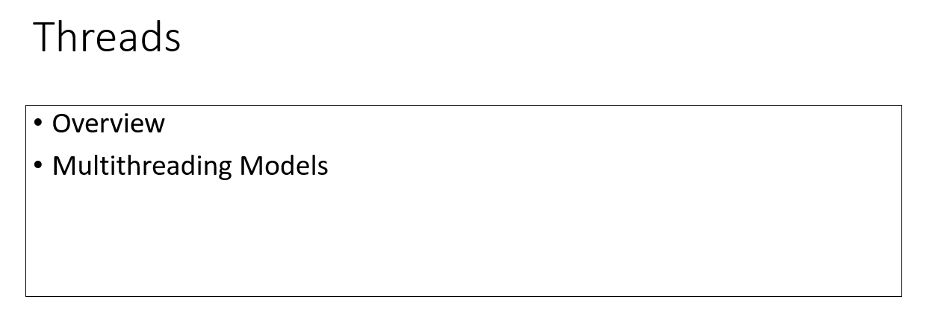
Multithreading Models
Dept. of CSE(CS), MSRIT

Slide 12
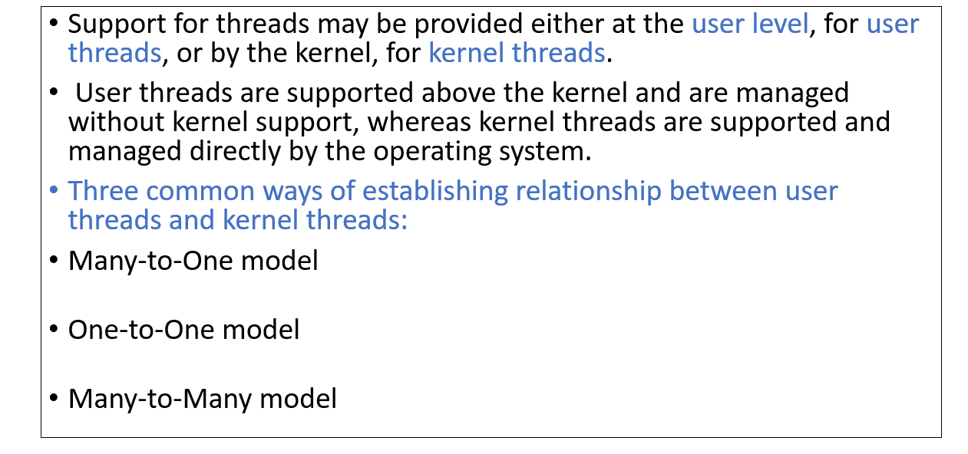
Multithreading Models
Dept. of CSE(CS), MSRIT

Slide 13
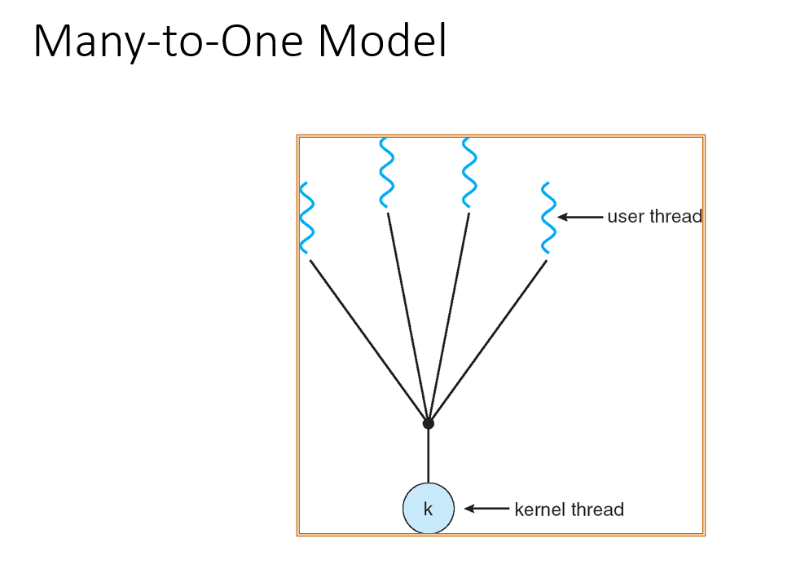
Multithreading Models
Dept. of CSE(CS), MSRIT

Slide 14
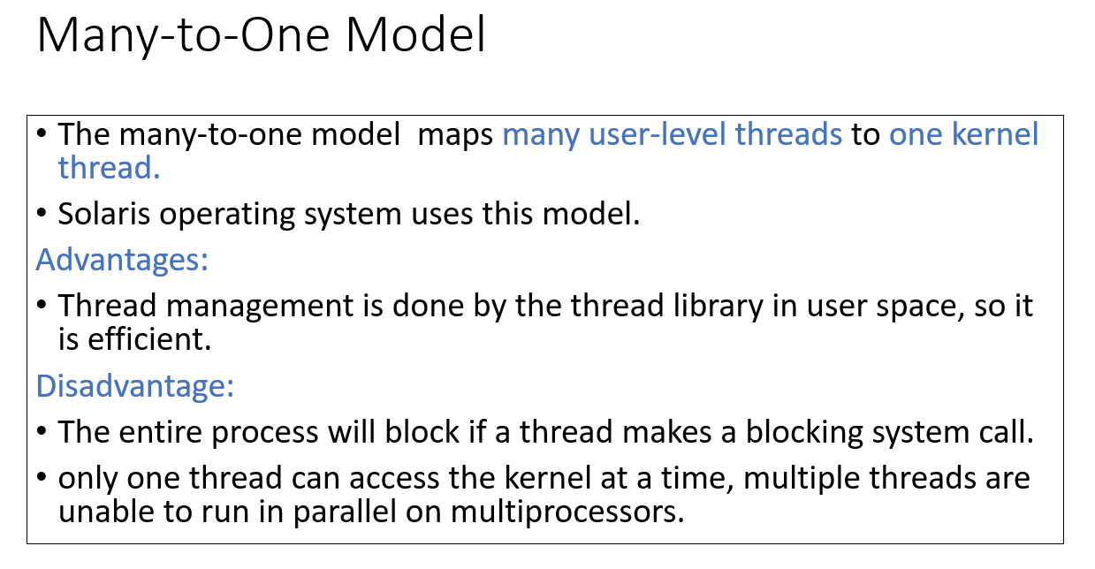
Multithreading Models
Dept. of CSE(CS), MSRIT

Slide 15
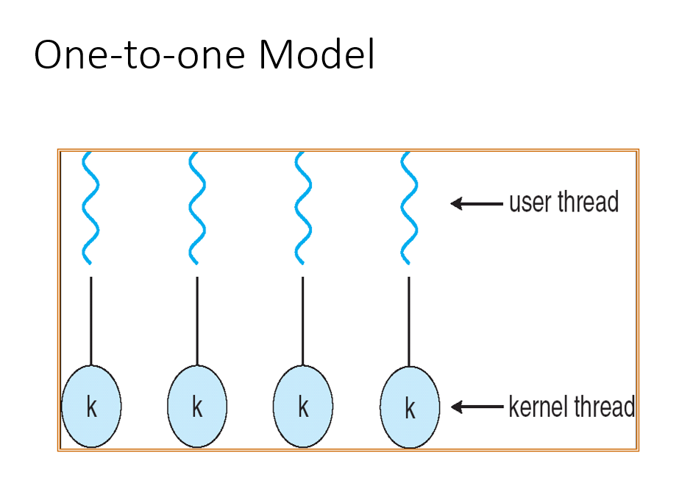
Multithreading Models
Dept. of CSE(CS), MSRIT

Slide 16
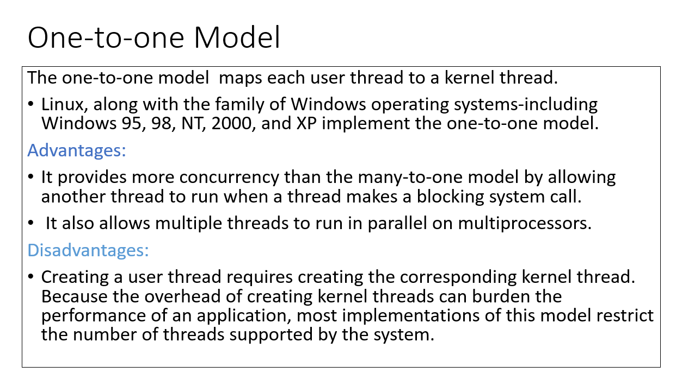
Multithreading Models
Dept. of CSE(CS), MSRIT

Slide 17
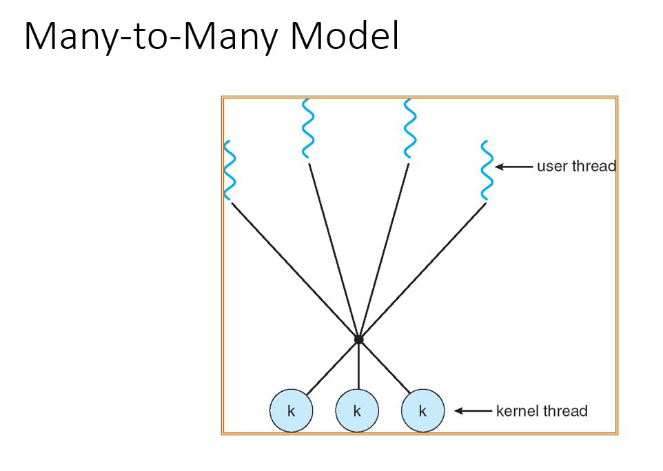
Multithreading Models
Dept. of CSE(CS), MSRIT

Slide 18
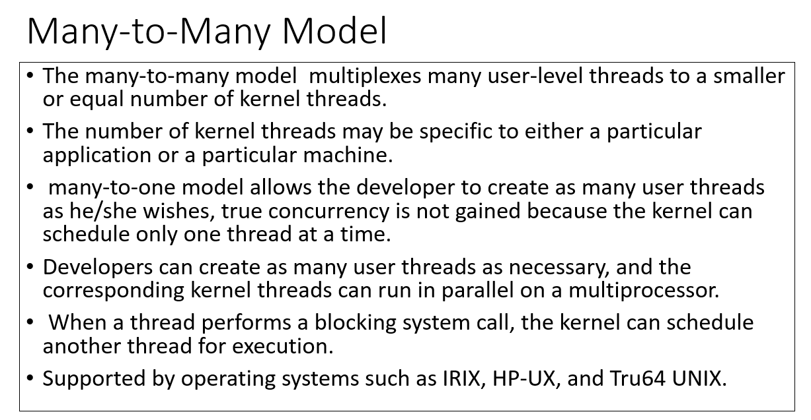
Multithreading Models
Dept. of CSE(CS), MSRIT

